Slide 1
Twitter Analysis - BDP Final Project
Neal Xu

Slide 2
Agenda
Executive Summary
Methodology
Source Data Overview & EDA
Feature Engineering
Data Cleaning-Up
Topic Selection
The Analysis (Author, Location, Timeline, and Uniqueness)
Summary Conclusion & Recommendation for Future Work

Slide 3
Executive Summary
Problem:
Whether Twitter can be considered a credible source of information, reflects the emergence of important trends or topics in education, specifically: “Biden’s college student debt relief”.
Solution:
Analysis of approximately 100 million Tweets (~500GB) using Google Cloud Platform.
Value:
This project helps us to understand if we should rely on social media such as Twitter for major decision-making that requires the gaining of the latest news.
Next Steps:
How credible are the original tweets that could be taken for topic knowledge gaining from non-authority entities?”

Slide 4
Methodology
Language & File Type
PySpark
PySpark DataFrame
Pandas
Platform
Data Frame
Main Functions & Packages
.select()
Method
Google Could Platform
Json
.filter()
.groupBy()
Spark RDD
.withColoumn()
.agg()
Pyspark.ml.feature
Jaccard Similarity = 0.5
MinHashLSH
With
rlike()
contains()
1
2
3
4
5

Slide 5
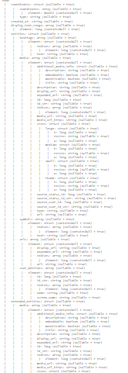
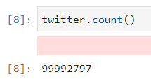
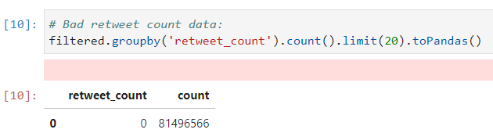

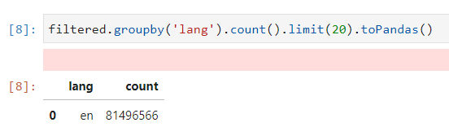
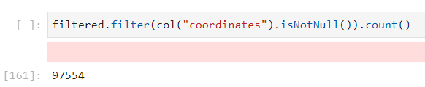
Source Data Overview & EDA
Too much irrelevant columns from: .printSchema()
Bad raw data variable:
Original Data Count:
retweet_count (all “null” values)
99992797
(almost 100 million)
All from year:
2022
Text language:
English only
Available coordinates
(Bad location variable)：
97554/99992797 = 1%

Slide 6





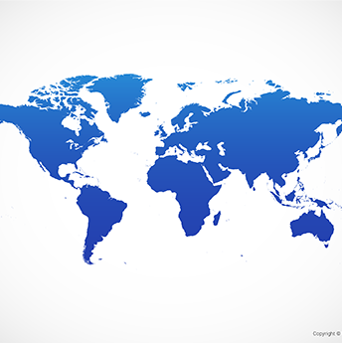


Feature Engineering
- Six new features were generated from the original data set and will be used for further analysis.
“user_name”
“user_description”
“user_screen_name”
“user_location”
From: user['name']
From: user['description']
From: user['screen_name']
From: user['location']
“place_location”
“place_country”
“retweet_count”
“retweeted”
From: place['full_name']
From: place['country']
From: retweeted_status['retweet_count']
From: retweeted_status['retweeted']

Slide 7
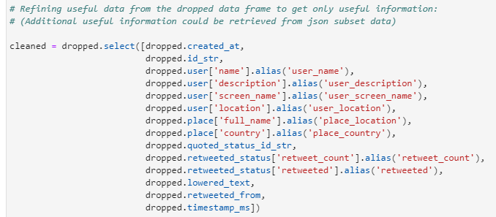
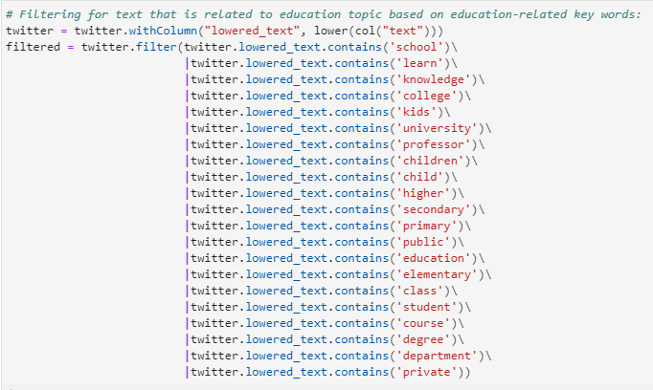
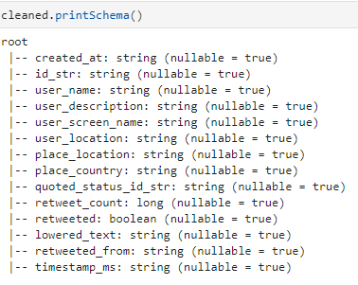

DATA Cleaning-Up
Filtering out tweets that are irrelevant to education
Selecting helpful variables
14 cleaned variables are kept
Filter out 18 million irrelevant data rows

Slide 8
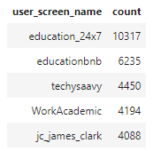
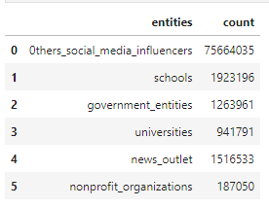
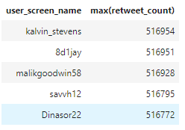
Author Identification Analysis
Top five most prolific Twitterers (Original Contents):
Top five most prolific Twitterers (Retweets):
Twitterers by the five entities (total)
The most prolific retweet count is significantly more than the original counts and “education_27” is the most active original content creator that is 40% more than the second-ranked user. In terms of the top retweet count, the top users have a similar count of around 500,000 retweets.
Most twitters are “other social media influencers”, the rest of them are equally distributed not including non-profit organizations and universities for around 1.2 to 1.9 million. Universities and non-profit organizations are only around 1/12 of the schools, governments, and news outlets.

Slide 9
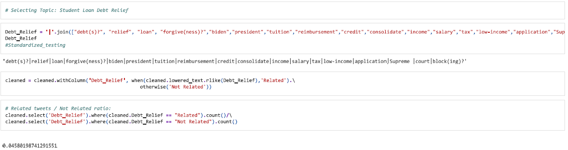
Topic Selection
The attached code below is used to label tweet text based on if the text is related to the selected topic.
(Around 4% of the tweets are related)
The education topic selected is:
“Biden’s college student debt relief”

Slide 10
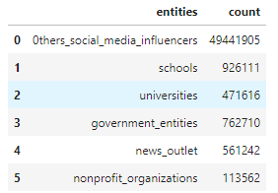
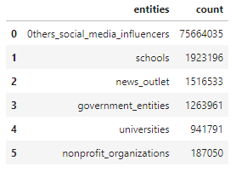
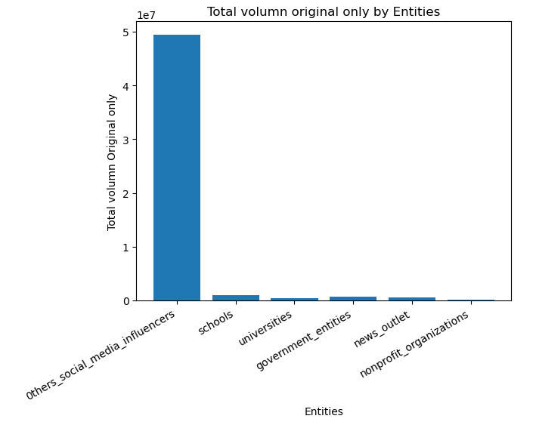
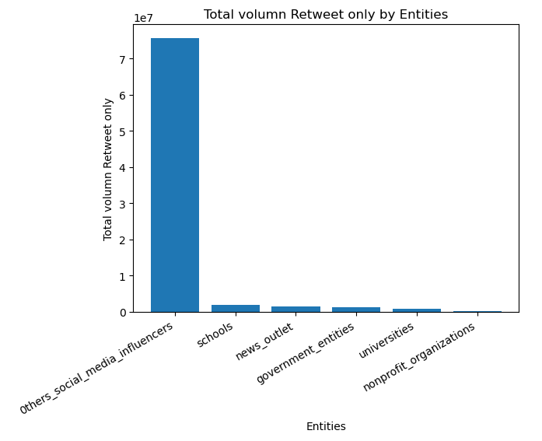
Distribution of tweet / retweet volume by Organizations
On the left side is the distribution of original tweets by different entities.
It is consistent with the previous analysis that the “other social media influencers” has the most significant original tweet counts since most accounts are grouped into this sector.
Here, schools and governments ranked the top two counts again and non-profit organizations still being the least active group.
On the left side is the distribution of retweets by different entities.
The distribution has a similar pattern to the original tweets by different entities. However, the difference is that the retweet count is almost twice the original content for each of the entities.
Here, schools and news outlets ranked the top two counts. The retweet for news outlets is almost three times its original content counts. While the non-profit organization still being the least active group.

Slide 11
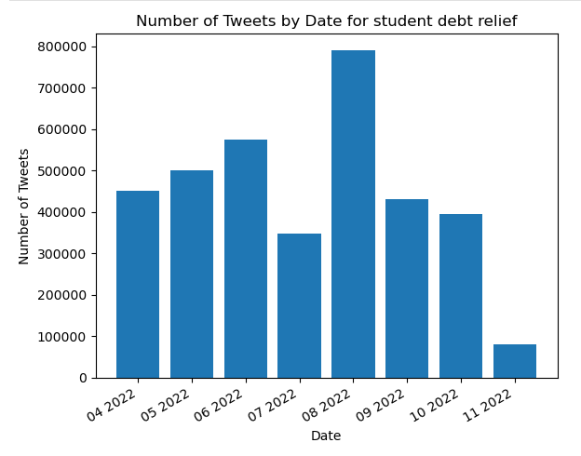
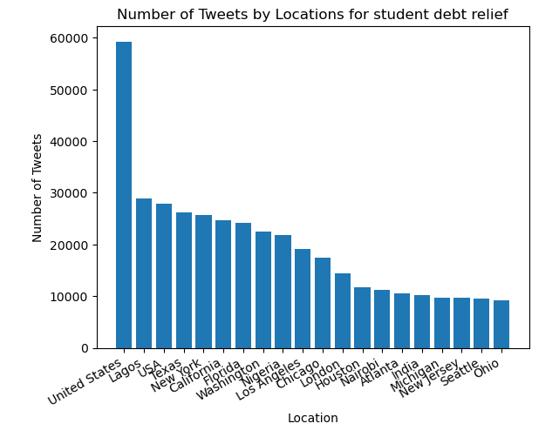
Time Analysis & Location
-The topic chosen for timeline and location analysis is “Student Loan Debt Relief”
The timeline below shows that the tweet amount related to the student loan debt relief surged during August 2022, the same time the news about Biden’s student debt relief came out.
(There are large gaps between months for the amount. A significant peak appeared during August 2022)
The visualized location analysis below shows that most of the tweets and twitters are located in the United States and in the cities where higher education institutes are located. It is consistent with the debt relief topics since it is a relief for American college students.
(The only location variable that could be used is from the location under “users”, however, the problem of mess still exists due to the locations users entered. Below is the best representation of the location.)

Slide 12
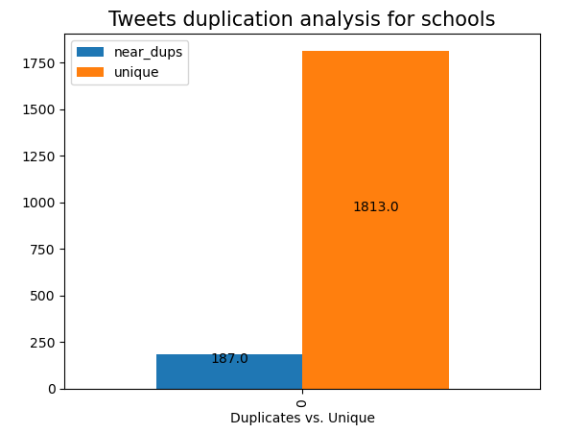
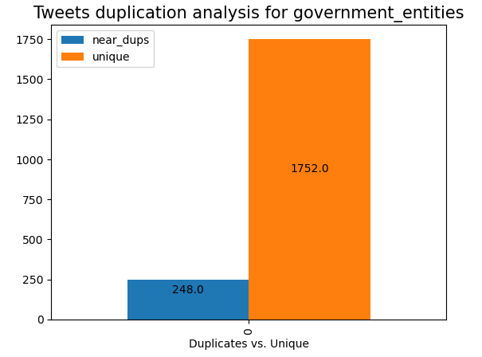
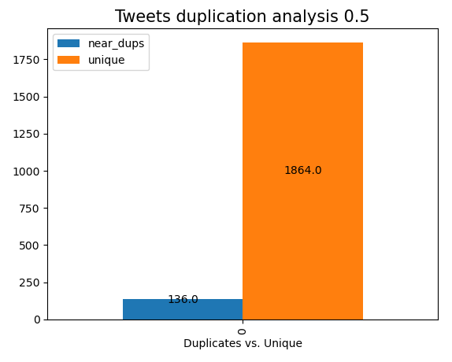
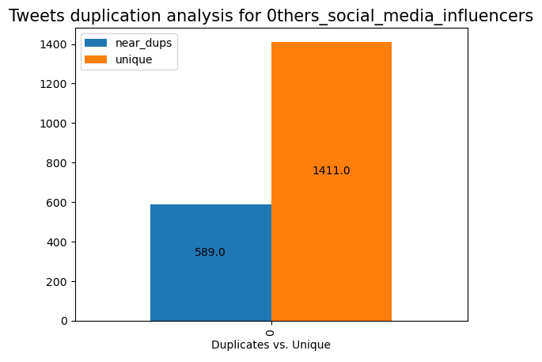
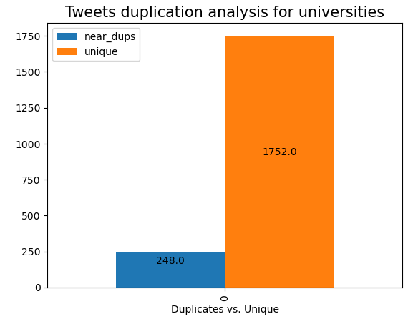
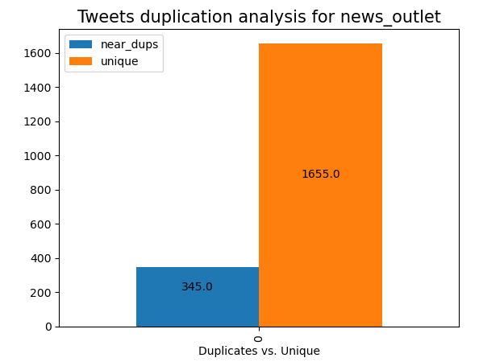
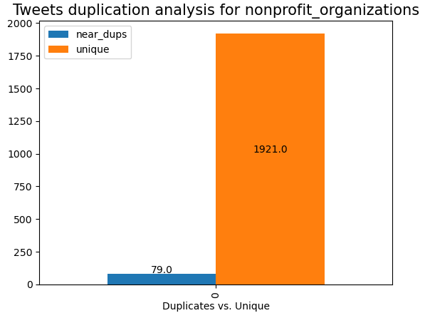
Uniqueness Analysis
Most Tweets are unique (2000 random samples):
The tweet uniqueness analysis by different organizations is visualized on both the lift and right sides and they have a similar pattern to the overall analysis that most tweets are unique tweets.
Most organizations including schools, governments, non-profit organizations, and news agencies mainly have unique tweets while other social media influencers have a higher rate of retweet count compared to the rest of the entities.
The threshold is set as 50 for maximum accuracy (Jaccard distance = 0.5) based on the Duplication text analysis.

Slide 13
Summary Conclusion & Recommendation for Future Work
Conclusion:
Twitter could be considered a source of information that can reflect the emergence of important trends or topics in education. It also could be useful for understanding the public’s opinion on a certain topic or trend in education.
However, based on the current analysis, it should not be considered a creditable source to obtain knowledge for the topic in general until further tweet analysis. Since most tweets are original content created by social media influencers other than authority agencies such as governments, schools, news, and non-profit organizations.
Future Work:
In addition to the current analysis, the analysis of the credibility of original tweets created by social media influencers could be the aim for the next step:
“How credible are the original tweets could be taken for topic knowledge gaining from non-authority entities?”

